Slide 1

“Secure Access”
Department of Computer Science and Engineerig
Engineering College Ajmer
Mentor : Mr. Avinash Bhandiya

Slide 2

Introducing the Virtual Password System
SecurePass Technologies presents the Virtual Password System: military-grade, PIN-based authentication. Go beyond traditional passwords and eliminate vulnerabilities with our innovative solution.

Slide 3

The Password Security Crisis
Stolen Credentials
Password Reuse
81% of data breaches involve stolen credentials.
65% of users reuse passwords across multiple accounts.
High Breach Cost
The average cost of a data breach is $4.35 million.

Slide 4





How It Works: The User Experience
User Registration
Users complete a simple registration form.
Admin Approval
Admins approve new user accounts.
Virtual PIN Generation
A unique virtual PIN is generated.
Secure Email Delivery
The PIN is securely delivered via email.
Two-Factor Verification
Users log in with credentials and the virtual PIN.

Slide 5
Military-Grade Protection Features
Cryptographic Hashing
Salt & Pepper
Virtual PIN Generation
SHA-256 for robust data encryption.
Enhanced security against rainbow table attacks.
Dynamic, temporary authentication codes.
Two-Factor Authentication
Zero Password Storage
Adds an extra layer of security.
No plain-text passwords stored on servers.

Slide 6
Seamless Authentication Experience
Registration Form
Initiate the process with user details.
Admin Approval
Quick review and activation by administrators.
Email PIN Delivery
Receive your secure virtual PIN.
Credential + PIN Login
Access securely with your credentials and PIN.
Secure Access
Gain entry to your account with confidence.

Slide 7
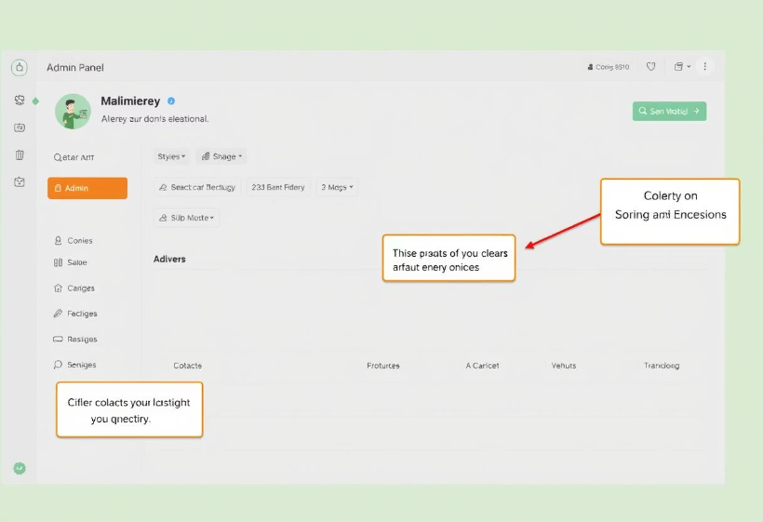
Centralized Management Console Features
Real-time User Statistics
Approval Workflow System
Virtual PIN Generation
Data Export Functionality
Audit Logs

Slide 8

Cryptographic Implementation
function generateVirtualPin(password) {
}
return 6-digit PIN;
// Key stretching implementation...
hash = sha256(hash + "SECURE_PEPPER");
hash = sha256(hash + salt);
const salt = randomString();
let hash = sha256(password);

Slide 9

Security & Business Value Benefits
99.8%
40%
Theft Prevention
Reduced Takeovers
Prevent credential theft effectively.
Decrease account takeover incidents significantly.
95%
User Adoption
High user adoption rate for seamless integration.
Our system eliminates plain-text password storage, ensuring regulatory compliance with GDPR and HIPAA. These benefits deliver immense security and business value.

Slide 10
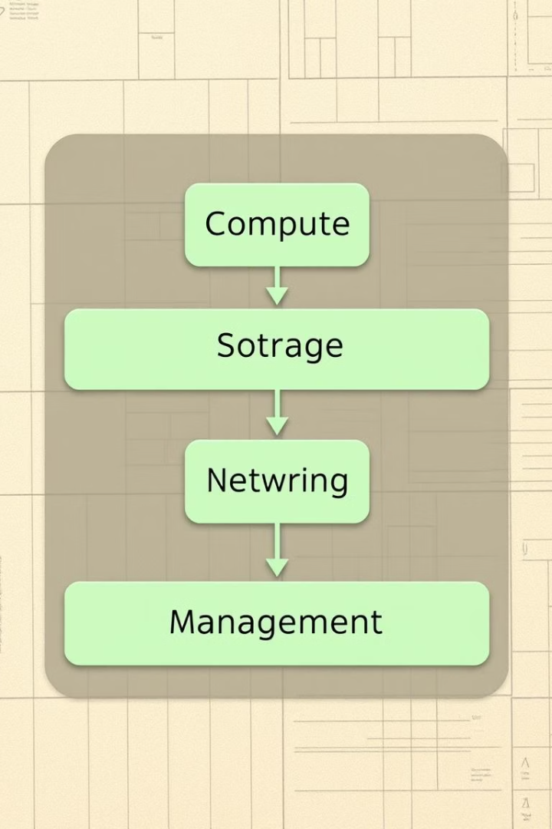




System Implementation Components
Frontend
Security
Storage
HTML5/Bootstrap/CSS3 for responsive design.
Custom SHA-256 + Salt-Pepper for robust protection.
LocalStorage Encryption for secure data handling.
Email
EmailJS Integration for reliable delivery.

Slide 11
Next-Generation Security Roadmap
Biometric Integration
1
Future-proofing with advanced biometric methods.
2
Blockchain Verification
Leveraging blockchain for enhanced PIN security.
Mobile App
3
Dedicated mobile application for convenience.
4
Enterprise SSO
Compatibility with enterprise Single Sign-On solutions.
AI Threat Detection
5
AI-powered systems for proactive threat identification.
Experience Tomorrow's Security Today.

Slide 12
Thank you !

